Slide 1
1. Analyze the following quote by George Washington.
2. Please complete a written response that describes your thoughts regarding the quote.
“I walk on untrodden ground. There is scarcely any part of my conduct which may not hereafter be drawn into precedent.”

Slide 2
President George Washington
PRESENTED BY:
THE HHS U.S. HISTORY DEPARTMENT
COACH B.O. STREETMAN, INSTRUCTOR

Slide 3
ENGAGEMENT!!

Slide 4
GEORGIA STANDARDS OF EXCELLENCE
SSUSH6: Analyze the challenges faced by the first five presidents and how they responded.

Slide 5
LEARNING TARGETS (STATEMENTS OF INQUIRY)…
1. I CAN explain the significance of key precedents set by George Washington during his Presidency.
2. I CAN analyze and describe President George Washington’s role in the Whiskey Rebellion.

Slide 6
SUCCESS CRITERIA
We will know that we are successful when we can explain the significance of key precedents set by George Washington during his Presidency.

Slide 7
MINI-LESSON: KEY VOCABULARY TERMS
What words and people do I need to know?
President George Washington
Precedents
The Whiskey Rebellion

Slide 8
EXPLORE, EXPLAIN, & ELABORATE !!

Slide 9
GEORGIA STANDARDS OF EXCELLENCE
SSUSH6: Analyze the challenges faced by the first five presidents and how they responded.

Slide 10
LEARNING TARGETS (STATEMENTS OF INQUIRY)…
1. I CAN explain the significance of key precedents set by George Washington during his Presidency.
2. I CAN analyze and describe President George Washington’s role in the Whiskey Rebellion.

Slide 11
SUCCESS CRITERIA
We will know that we are successful when we can explain the significance of key precedents set by George Washington during his Presidency.

Slide 12
MINI-LESSON: KEY VOCABULARY TERMS
What words and people do I need to know?
President George Washington
Precedents
The Whiskey Rebellion

Slide 13
GEORGE WASHINGTON: PRECEDENTS

Slide 14
GEORGE WASHINGTON VIDEO

Slide 15
GEORGE WASHINGTON: PRECEDENTS
Precedent: an earlier event or action that is regarded as an example or guide to considered in subsequent similar circumstances

Slide 16
GEORGE WASHINGTON: PRECEDENTS
First Precedent: Established a Cabinet within the Executive Branch that was not outlined in the U.S. Constitution
Second Precedent: Support the concept of a National Bank and a national debt which would be utilized later.

Slide 17
GEORGE WASHINGTON: PRECEDENTS
Third Precedent: Introduced a policy of neutrality in foreign wars that lasted until World War I in 1917.
Fourth Precedent: Established the two term limit for U.S. Presidents which was honored by all Presidents until Franklin Roosevelt when he ran for a third term in 1940 and a fourth term in 1944.

Slide 18
GEORGE WASHINGTON: PRECEDENTS
Fifth Precedent: Established good relationship with Great Britain with the establishment of Jay’s Treaty. Britain (The United Kingdom) is still one of America’s strongest allies
Sixth Precedent: Established the tradition of a Presidential farewell address to the nation

Slide 19
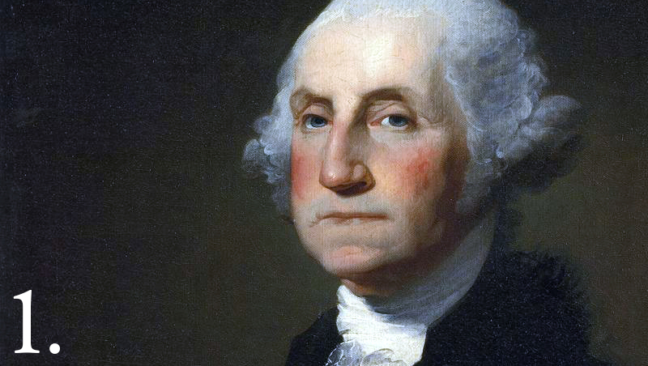
President George Washington Precedents Bubble Map
Directions: List precedents set by President Washington in the bubble map

Slide 20
THE WHISKEY REBELLION
Takes notes from the slides
Copy the text in red.

Slide 21
Whiskey Rebellion
To help pay off the war debt, Washington started to tax whiskey
Whiskey is an alcoholic beverage
The farmers who grew the grain to make the whiskey were angry.

Slide 22
Why whiskey?
Farmers had a hard time getting their grain to market, so they turned their grain into whiskey, which was easier to transport.
They got more money for the whiskey anyway.
Farmers traded the whiskey for salt, sugar, and other goods.
Farmers used whiskey as money to get whatever supplies they needed.
Farmers did not have the money to pay for the tax.

Slide 23
The Rebellion
In the summer of 1794, a group of farmers in Western Pennsylvania rebelled against the whiskey tax and staged the Whiskey Rebellion.
One group beat up a tax collector and coated him with tar and feathers.

Slide 24
Why do you think tax collectors were tarred and feathered?

Slide 25
The Government Responds
Alexander Hamilton wanted the government to look strong. He encouraged President Washington to stop the revolt.
Federal troops marched to Western Pennsylvania and put down the revolt.
Washington had proved that the government would deal with people not obeying the law.

Slide 26
Why do you think Washington chose to lead the troops himself?

Slide 27
WHISKEY REBELLION VIDEO

Slide 28
SHAY’S REBELLION
WHISKEY REBELLION
Compare and contrast Shay’s Rebellion and the Whiskey Rebellion
5
3
5

Slide 29
EVALUATION!!

Slide 30
GEORGIA STANDARDS OF EXCELLENCE
SSUSH6: Analyze the challenges faced by the first five presidents and how they responded.

Slide 31
LEARNING TARGETS…
1. Explain the significance of key precedents set by George Washington during his Presidency.
2. Students will be able to analyze and describe President George Washington’s role in the Whiskey Rebellion.

Slide 32
SUCCESS CRITERIA
We will know that we are successful when we can explain the significance of key precedents set by George Washington during his Presidency.

Slide 33
MINI-LESSON: KEY VOCABULARY TERMS
What words and people do I need to know?
President George Washington
Precedents
The Whiskey Rebellion

Slide 34
GEORGE WASHINGTON CIRCLE MAP

